Slide 1
Automobile Manufacturing
Overall Testing Requirements

Slide 2
Testing phase of Automobile manufacturing
Although testing is generally considered an auxiliary process and a mundane one to do, it plays a critical role in Automobile manufacturing as the margin for error is extremely narrow and even small errors can cause significant damages to life and property. There are several phases and standards involved in this process.
There are various Automotive Industry Standards which ensure regulatory standards are met in different phases of automobile manufacturing; for example AIS007-Information on Technical Specifications to be submitted by the Vehicle Manufacturer, AIS-004 / 1999-Electromagnetic Radiation from Automotive Vehicle - Permissible Levels and Methods of Tests.

Slide 3
Main phases involved in Testing
Design validation
Quality testing
Fuel Economy
Performance and Transmission
Electronics
Driver comfort
Crash
Autonomous Driving
Track and On-road
Emissions
Vehicle evaluation

Slide 4
Quality Testing
This phase involves testing the automobile for part response, structural integrity and basic defects. The main requirements are:
Sensors of high precision
Measurement metrics and calibration
Technology such as ultrasound or infrared
Level of automation
Syncing with assembly line
Quick response and minimum error margin
Suggestion of fixes

Slide 5
Electronics testing
This phase involves testing the automobile for any electronic malfunctions and to make sure the core systems such as audio, engine electronics, transmission electronics and so on are in perfect working condition. Some of the requirements for an electronics testing system are:
Power consumption measurement
Audio Testing
SIgnal generation testing
Entertainment systems testing
Integrated system testing
Environmental simulation
Wireless testing

Slide 6
Fuel Economy
This phase involves a testing the vehicle for fuel economy. This test is important as it checks the vehicle for various important factors like fuel consumption, amount of carbon in the exhaust and more. The main component used here is a Dynamometer in a laboratory, which ensures consistency. The software doesn’t look at what is left in the tank. Rather, it measures the amount of carbon in the exhaust to determine how much fuel wa used. Some of the requirements for an fuel economy testing are:
Engine in good state
Softwares like Dynamic Skip Fire, AVL, Intertek, DEWESoft, SWRI etc.

Slide 7
Fuel Economy
Some of parameter involved in this phase of testing are:
Total Time of Engine running
Top Speed
Average Speed
Maximum Acceleration
Idle Time
Engine Start

Slide 8
Vehicle Evaluation
This phase involves vehicle inspection. This procedure is mandated by national or subnational governments in many countries, in which a vehicle is inspected to ensure that it conforms to regulations government safety, emission, or both. Inspection stations are places to drive inside to see if a vehicle passes inspection once a vehicle is due for inspection. Compliance checks, Condition checks, Function checks, Road test, Emission Test etc. Some of the requirements for vehicle evaluation are:
Check Body Damage
Test Drive vehicle
Car inspected by a qualified mechanic
Vehicle history report
Car’s service record

Slide 9
Brake testing
Performance testing of automotive brakes involves determination of stopping time, distance and deceleration level. Braking performance of an automobile is required to be ensured for various surfaces like dry, wet, concrete, bitumen etc. as well as for prolonged applications. Various brake testing standards are used worldwide to assure vehicle and pedestrian safety i.e Automotive Research Association of India(ARAI), American Society for Testing Materials(ASTM) etc. There are 2 main kinds of brake tests:
Speed window tests: Distance covered between 2 speeds.
Brake trigger tests: Distance travelled from application of brakes to a standstill.

Slide 10
Wheel testing
Wheel testing involves a series of tests that are carried out to meet vehicle OEM (original equipment manufacturer) requirements or the specifications of test standards on bending fatigue, radial fatigue, biaxial impact, energy absorption, radial impact or torsion.

Slide 11
Ergonomics
Ergonomics testing involves the consideration of several factors such as driver seat position, headrest position, leg room, placement of vehicle controls such as ignition, door handle grip, display text size, voice controls etc, boot space and much more.
RAMSIS is the world leading 3D-CAD-ergonomics tool for the ergonomic development of vehicles and cockpits.

Slide 12
Engine testing
An engine test stand is a facility used to develop, characterize and test engines. The facility, often offered as a product to automotive OEMs, allows engine operation in different operating regimes and offers measurement of several physical variables associated with the engine operation. A sophisticated engine test stand houses several sensors (or transducers), data acquisition features and actuators to control the engine state. The sensors would measure several physical variables of interest which typically include:
crankshaft torque and angular velocity
intake air and fuel consumption rates
air-fuel ratio for the intake mixture
environment pollutant concentrations in the exhaust gas such as carbon monoxide, different configurations of hydrocarbons and nitrogen oxides, sulfur dioxide, and particulate matter
temperatures and gas pressures at several locations on the engine body such as engine oil temperature, spark plug temperature, exhaust gas temperature, intake manifold pressure
atmospheric conditions such as temperature, pressure, and humidity

Slide 13
Crash Test
A crash test for a vehicle safety is a type of destructive testing undertaken to ensure that standards for safe design with regards to crash compatibility and crashworthiness are followed for different transportation modes. A crash laboratory is an outdoor track with highly advance crash simulator and test in slow motion.
It minimizes losses such as death, injuries and property.
Crash test general have these:
Crash test facility
Car/ Vehicle
Sensors and simulators
Dummies
Rating System

Slide 14
Crash Test
Different types of crash test are:
A. Frontal-impact test:
It’s the most common type of test, the vehicle is sent at a certain speed into a solid wall made of concrete.
B. Offset test:
In this test only one area of the front of the vehicle is impacted into a wall, the forces remain just like in the frontal impact, but only an area of the vehicle has to absorb the shock.
C. Small overlap test:
In this test only a small area of the car hits an object, like a tree or a pole. This test in demanded because it focuses the forces on the vehicle internal structure at any given velocity.
D. Side impact test:
This test is important because the side of the vehicle is usually not very rigid and an accident involving side impact can cause fatal injury to the occupants of the vehicle.

Slide 15
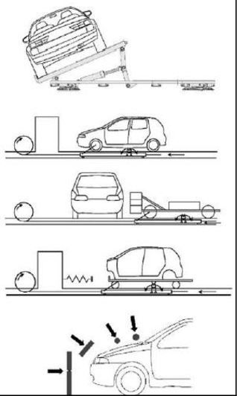
Crash Test
Roll Over test
Frontal impact test
Side impact test
Offset test
Pedestrian impact test

Slide 16
Crash Test
E. Roll-over test:
This test is required to verify if the vehicle can support itself, mainly the pillars, in a crash involving roll-overs.
F. Computer simulation:
This test is a computer simulation of an accident in a digital environment, similar to live tests. It is useful because if it’s precise simulation and low cost.
G. Pedestrian impact test:
In this test a crash test dummy is positioned vertically to imitate a pedestrian and the vehicle is accelerated at a speed of 40 km/h, and sent into the dummy.
H. Side pole impact test:
In this test the vehicle is positioned sideways on a moving platform and sent into a stationary rigid pole at a speed of 29 km/h.

Slide 17
Crash Test
Crash Test Dummies In the automotive industry, when conducting impact test, the different safety programs use crash test dummies, or ATD’s (Anthropomorphic Test Device). These devices replicate the human body with its dimensions, weight, and body motion characteristics.
Crash test dummies before being used in impact tests, they are calibrated and equipped with different measuring devices, in the head in neck there are tri-axial accelerometers, in the chest there is a force cell and a device to measure chest deflection, and in the knees there are load cell to measure the force of the impact. Also the dummies have a human like silicone based skin to mimic the tearing of the skin when in comes in contact with different parts of the vehicle.
The rating software analyses sensor fusion data, images of the car before and after the crash, and rate the car based on results.
The simulation software can be used to minimize the damage at the actual crash test site, by analyzing the data. Once designers have outlined a car’s basic form, they use the finite element method (FEM) to model its shape by plotting many interconnected points on the car’s surface. Software then calculates how the forces in a crash would affect each of those points to determine the overall result of the impact.

Slide 18
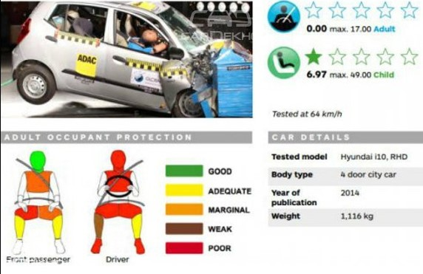
Crash Test
DEWESoft, TAAL, Aerodrome ESI Virtual Crash Test, Honda Crash test simulation.

Slide 19
Autonomous Driving Test
Autonomous Driving is a complete feedback loop. A system which is capable of handling Sensor data, process real world information by using GPU’s for better performance, and run AI and ML algorithms with predefined data-set.
It must have Computer Vision, Deep learning, Sensor Fusion, Localization, Planning, Control, System Integration.
Self driving cars in general have four main software components.
Perception : Allows cars to perceive their environment and make sense of it.
Localization : Gives car it's location .
Planning : Given the localisation and perception, how should the car move.
Control : Given the plan, what signals should the car send to the motors.
Self driving cars in general have three main hardware components.
Sensors : Components that allow the autonomous to take in raw information about the environment.
V2X technology (V2V and V2I technology): V2V and V2I components enable the autonomous vehicle to talk and receive information from other machine agents in the environment.
Actuators: Actuators are the components of a machine responsible for controlling and moving the system.

Slide 20
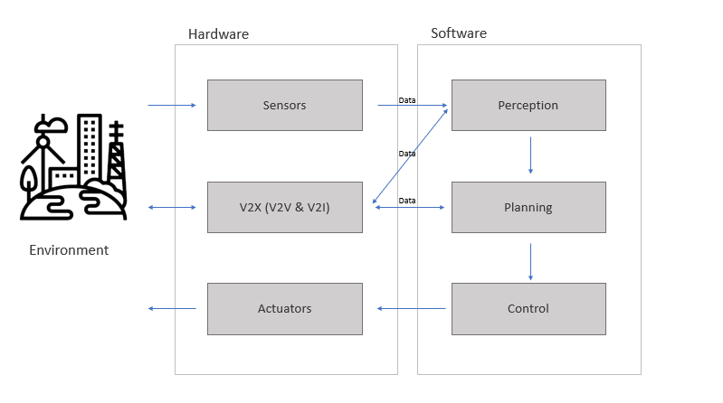
Autonomous Driving Test

Slide 21
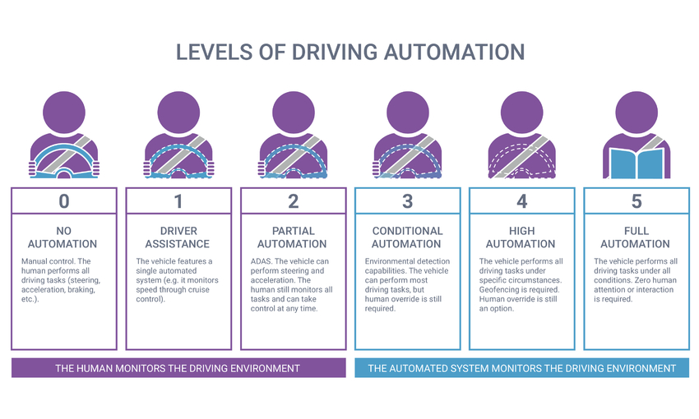
Autonomous Driving Test

Slide 22
Autonomous Driving Test
Virtual Test Drive (VTD) :
VTD is an open platform for creation, configuration, and animation of virtual environments for the testing and validation of Autonomous Vehicles. The simulator can create a wide range of testing environments and scenarios. The stream of data can then be used to train the AI Driver at all levels or to assess its performance in terms of safety, comfort and efficiency.
2. Vehicle CAE Model :
Depending on the scenario that the simulation needs to address, having vehicle models with different level of complexity can be handy. a simplified model is preferred so a higher number of scenario permutations can be verified in a given amount of time.
3. Sensors and Sensor Models:
VTD has a complete set of sensors to replicate the physical sensors used in an autonomous vehicle: cameras , LiDAR, RADAR and ultrasonic sensor. Each sensor can be represented with different levels of fidelity, from reproducing the intricacies of a laser beam reflecting over rough surfaces to simply capturing the basic sensor characteristics.

Slide 23
Autonomous Driving Test
4. 3D Driving Environment
A 3D virtual environment can be generated either from inside VTD, or from scanning the actual roads. Creating the environment inside VTD gives you maximum control over all the details, while generating the 3D environment from measurements (LiDAR/camera) is more realistic and much faster.
5. Scenarios and Data Management
With millions of scenarios to be evaluated at each step of the autonomous vehicle development, there is simply no way to manage everything manually. That is where the simulation management platform comes into play to store the generated data and appropriately label them for easy access at any stage.
6. Artificial Intelligence (AI) Driver
The AI Driver is the core of every autonomous system, and users can easily connect VTD to their own AI Driver to carefully validate them under all conditions, including sensor failure or misbehavior.

Slide 24
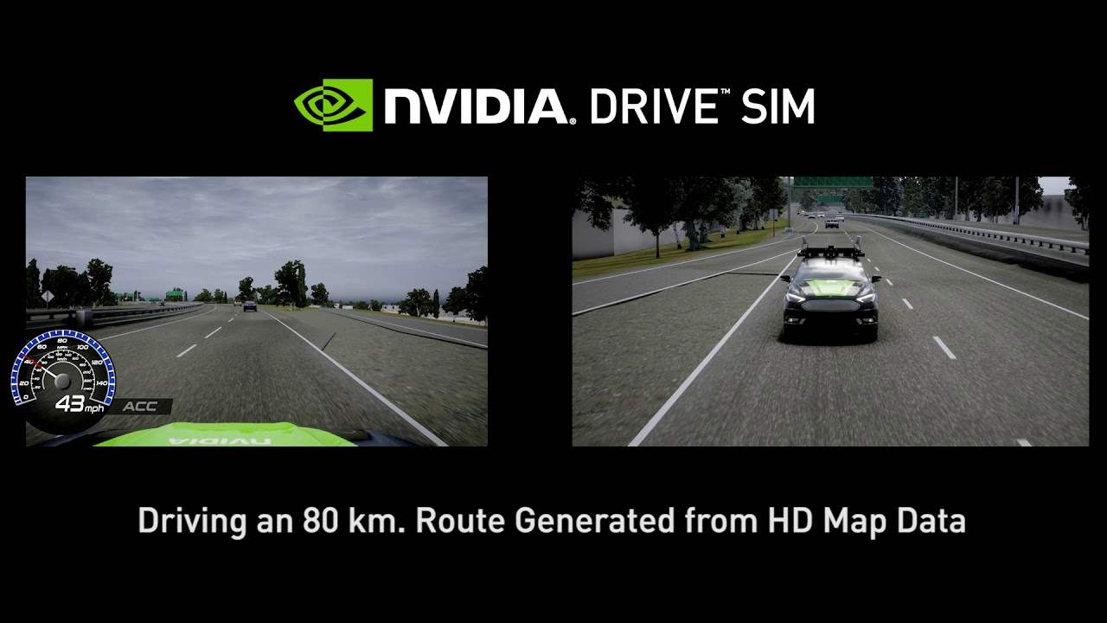
Autonomous Driving Test
Intertek, CADET , DEWESoft, MSCS Vires VTD, AB Dynamics, Nvidia Drive Sim(VTD).

Slide 25
Performance and Transmission
Road to Rig Approach
In-house vehicle testing and application under real driving conditions
Any powertrains from small cars to SUVs can be tested on one and the same rig without having to change the setup. The unit under test is thus subjected to identical conditions as in real road testing. You can configure any type of roads and surfaces on the KS R2R 4x4’s host computer - such as dry, rainy or snowy conditions.
The Test System must be flexible to develop various transmission types:
Manual Transmission (MT)
Automatic Transmissions (AT)
CVT-Transmission
Automated Manual Transmissions (AMT)
Double Clutch Transmissions (DCT)
Transmissions for Hybrid Electrical Vehicles (HEV)
Entire power transmission can be virtually simulated using SIMULINKS
Speed and endurance testing can also be done

Slide 26
